Slide 1
Healthcare 4.0 – Transformative technologies for patient-centric healthcare
DTU Centre for Collaborative Autonomous Systems
Seminar
November 8 2021, 08:30 – 13:30
Technical University of Denmark
Odense Robotics is co-financed by Ministry of Higher Education and Science and the Danish Board of Business Development

Slide 2
Seminar program
Time | Activity
08:30 – 09:00 | Registration and breakfast
09:00 – 09:10 | Opening and welcome HoC Roberto Galeazzi (DTU) and Christina E. Wanscher (Odense Robotics)
09:10 – 09:50 | The neurorobotics vision of a new understanding of the brain Assoc. Prof. Silvia Tolu (DTU Elektro)
09:50 – 10:30 | Future interfaces for rehabilitation robotics Prof. John Paulin Hansen (DTU Management)
10:30 – 11:00 | Coffee break and networking
11:00 – 11:40 | Muscle Controlled Functional Electric Stimulation for Upper Limb Stroke Rehabilitation Assoc. Prof. Sadasivan Puthusserypady (DTU Health Tech)
11:40 – 12:20 | Motivational playful technology with rapid health effects Prof. Henrik Hautop Lund (DTU Elektro)
12:20 – 12:30 | Closing remarks HoC Roberto Galeazzi
12:30 – 13:30 | Networking with light lunch

Slide 3
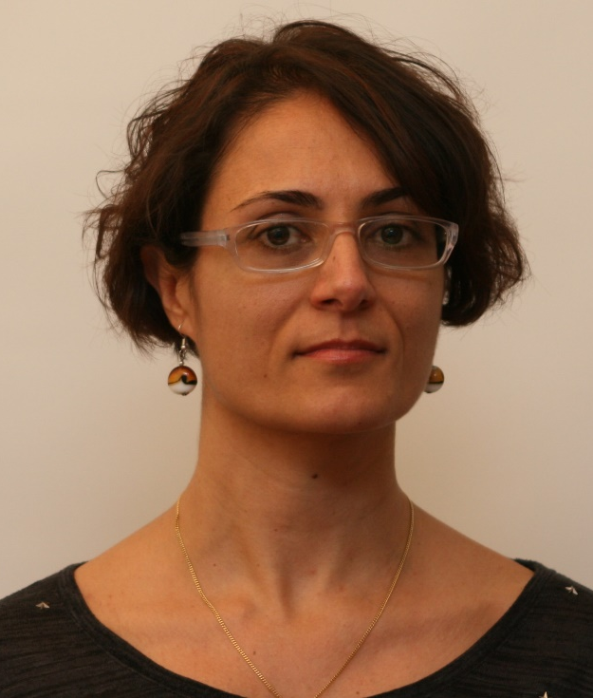
Silvia Tolu Associate Professor @ DTU Elektro
The neurorobotics vision of a new understanding of the brain
Abstract - Computational brain models interfaced with robots (neuro-robots) allow reproducing human capabilities and getting insights into the neural mechanisms underlying behaviour. This talk will discuss if we can use such understanding to develop new tools for early diagnosis of neurodegenerative diseases and test new strategies for treatment.
Bio sketch - Silvia Tolu leads the Neurorobotics team at DTU. Her research aims at discovering methods and technologies for enabling autonomy in robots and for diagnosis and rehabilitation of neurodegenerative diseases. She has published in influential journals in robotics and computational neuroscience and she is review editor for Frontiers in Neurorobotics.

Slide 4
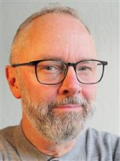
John Paulin Hansen Professor @ DTU Management
Future interfaces for rehabilitation robotics
Abstract - This talk will address some of the challenges and potentials we see when designing interfaces to exoskeletons for stroke patients. How can we motivate patients by gamification? Is BCI- or gaze- interaction a viable solution? Can digital twins be used for visualizations of clinical data? And how may AR-technology be applied in at-home training?
Bio sketch - John Paulin Hansen is a Bevica professor in the Innovation Division at DTU. His research areas are human factors and human-computer interaction with a special focus on innovation, e-health, and usability of new technology. The Bevica Foundation supports John´s research laboratory “GazeIT”.

Slide 5
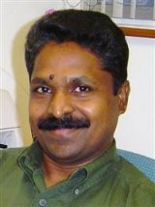
Sadasivan Puthusserypady Associate Professor @ DTU Health Tech
Muscle Controlled Functional Electric Stimulation (FES) for Upper Limb Stroke Rehabilitation
Abstract - Stroke is a life-changing event that can affect the subjects’ emotional state as well as their physical functions. Among the stroke survivors, around 50% suffer from upper limb paresis. In this talk, the development of a novel muscle stimulator (Myo-FES) for upper limb rehabilitation (wrist extension and flexion) of stroke survivors is discussed.
Bio sketch - Sadasivan Puthusserypady leads the BCI group at DTU Health Tech. He has more than 32 years of research experience in Biomedical Signal Processing. Recent research focuses in home healthcare, welfare technology; devising high quality and user-friendly BCI assistive systems for disabled/elderly to help them lead an independent life.

Slide 6
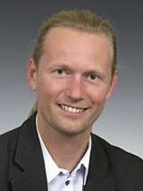
Henrik Hautop Lund Professor @ DTU Elektro
Motivational playful technology with rapid health effects
Abstract - Playful technology is shown to increase in cognitive, physical, and social skills in scientific effect studies. Playful technology training gives significant health effects with substantially less training sessions than what is needed with traditional training methods.
Bio sketch - Henrik Hautop Lund leads the Center for Playware at the Technical University of Denmark. He is World Champion in RoboCup Humanoids Freestyle 2002, he has published more than 200 scientific publications and holds patents in more than 35 countries.

